Slide 1
Typhlological Museum
Zagreb, Croatia
Notes:
Typhlological Museum was nominated and awarded the „Živa Award 2015“ in the category Attention to the visitor and openness. This is how Typhlological Museum was presented in Sankt Petersburg …
Typhlological comes from the Greek word typhlos, which means blind – a blind person.

Slide 2
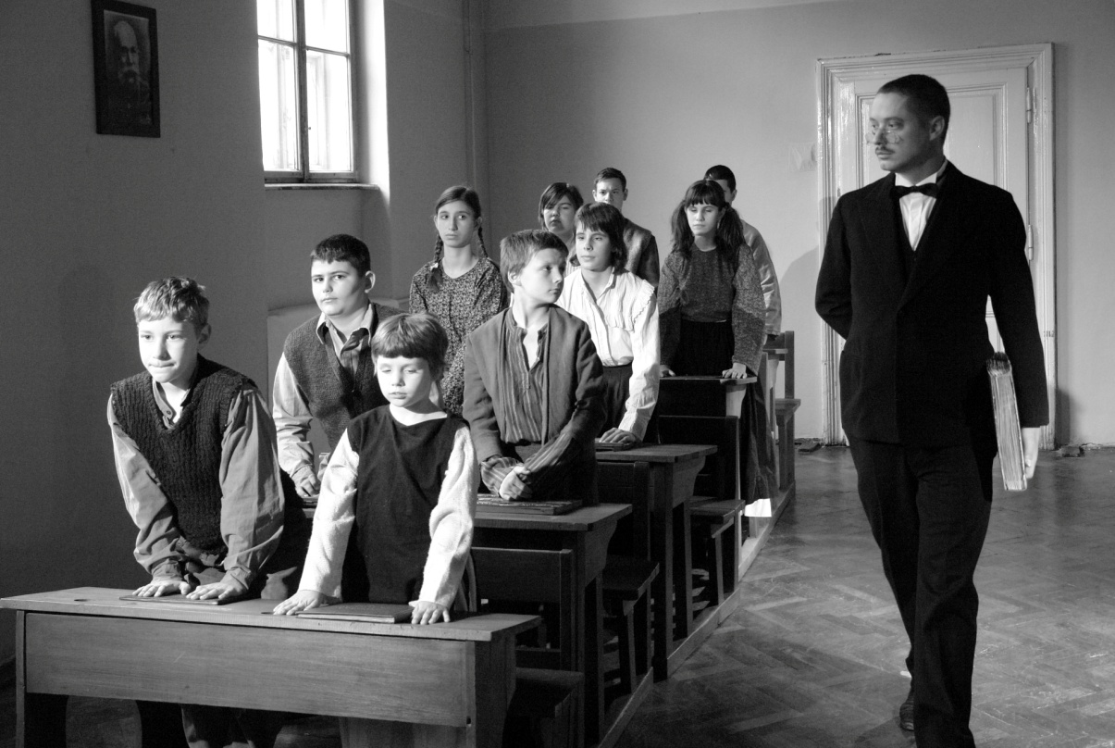
The Živa Award 2015, May, Saint Petersburg
The foundation initiative - teacher Vinko Bek, the end of the 19th century
The foundation of the museum - Zagreb, 1953
Notes:
The origins of our Museum go back to the end of the 19th century, when Vinko Bek started to collect items for the Croatian Museum for the Blind. That was his private collection. He was a great fighter for the rights of Blind people, a typhlopedagogist and a teacher.
Some sixty years later, in 1953, the Typhlological Museum of the Yugoslav Blind Union was opened with its centre in Zagreb, Croatia.

Slide 3
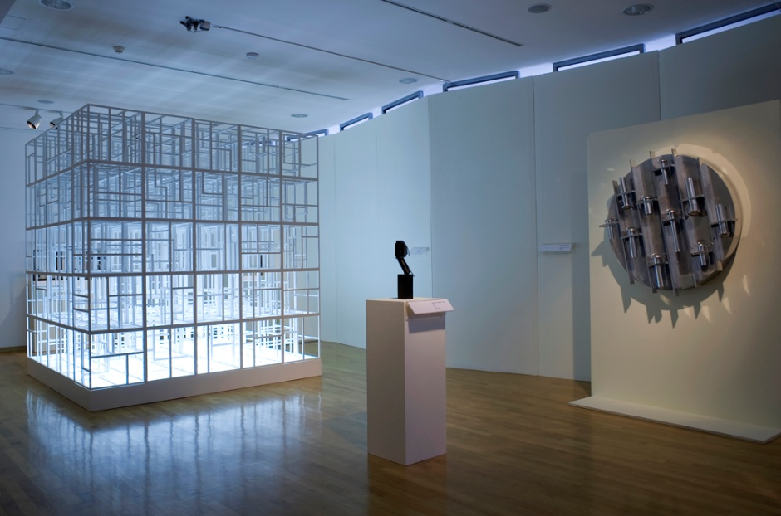
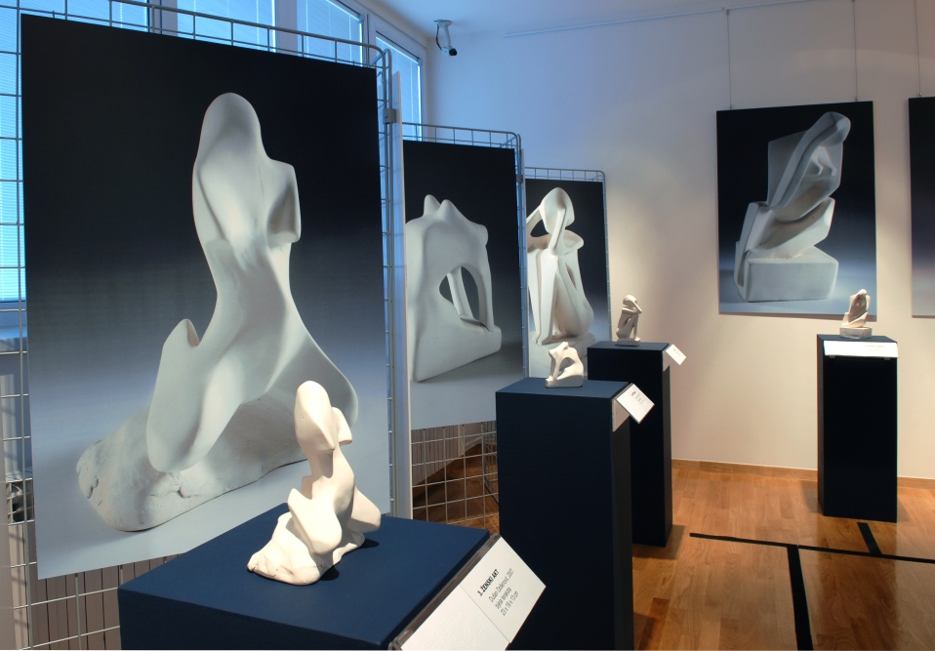
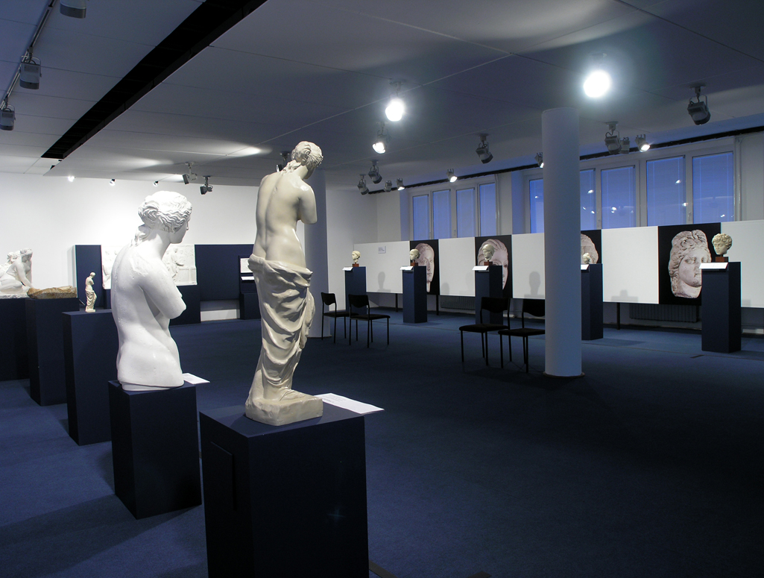
The Živa Award 2015, May, Saint Petersburg
Tactile gallery – since the 1960s
Notes:
The Tactile Gallery was opened in the 1960s, when we started to exhibit sculptures by blind authors and our public had the possibility to touch them. That was the possibility that did not exist in other museums at that time. Through the Tactile Gallery many sculptors have exhibited until today.

Slide 4
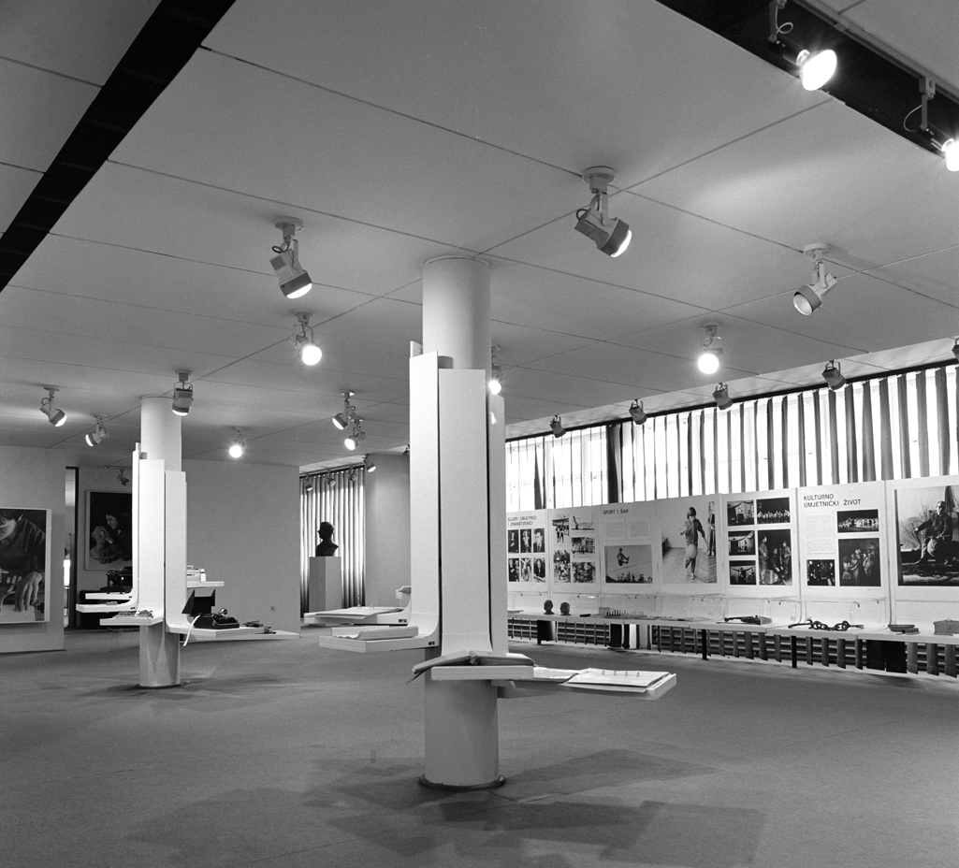
The Živa Award 2015, May, Saint Petersburg
2002 - The new management
      Museum reorganization
      Persons with disabilities
Notes:
Starting anew in 2002 – The Ministry of culture established the new management: The museum collections and documentation were revised, collections were reorganized, documentation system was implemented... We started to deal with the problems of the people with disabilities as a whole, not just the problems of the visually impaired and many other things…

Slide 5
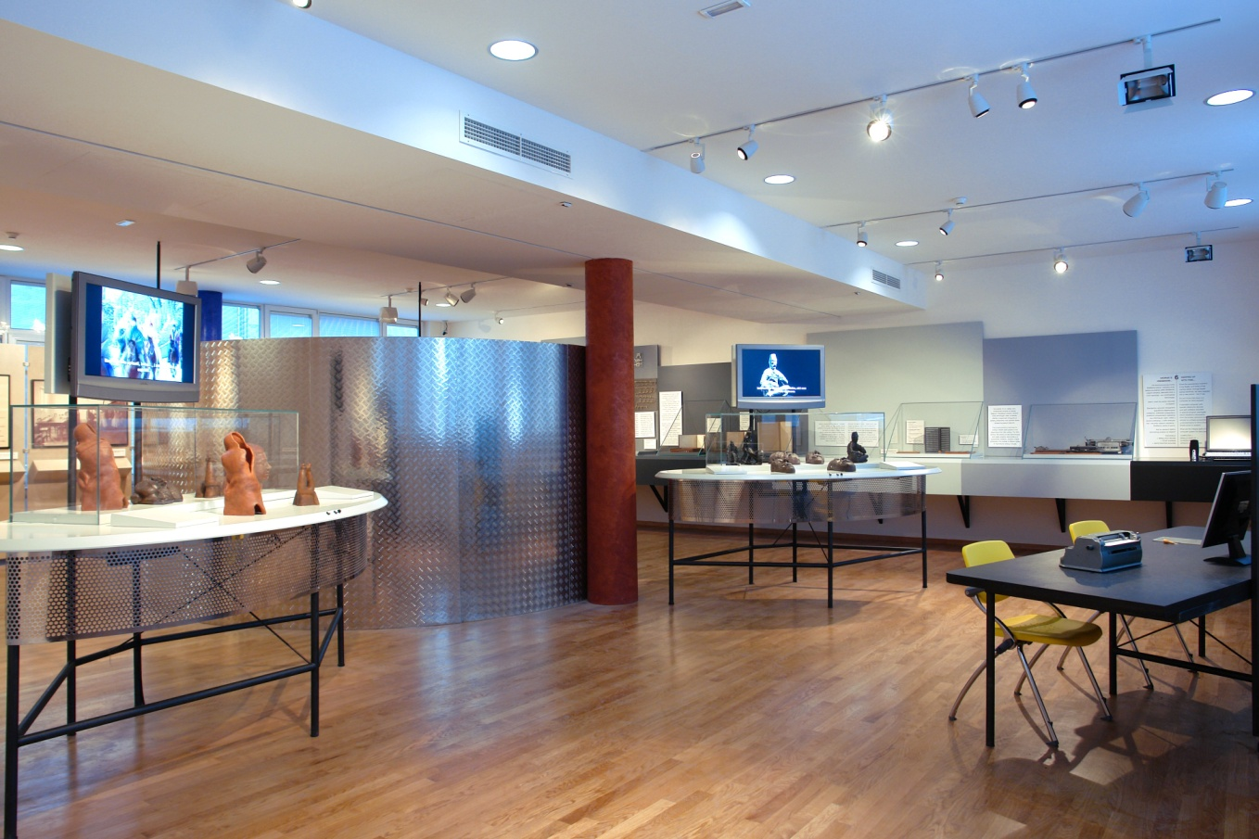
The Živa Award 2015, May, Saint Petersburg
2008 - the adapted museum, the new permanent exhibition
Notes:
In 2008, we adapted the whole museum space and opened the new permanent exhibition, the 4th in the museum’s history.

Slide 6
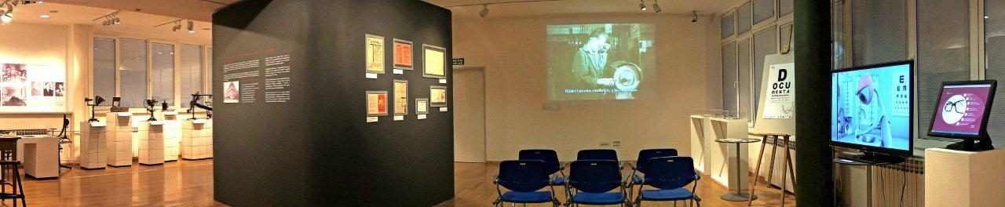
The Živa Award 2015, May, Saint Petersburg
2008 - the adapted museum, the gallery
Notes:
The permanent exhibition deals with the visually impaired people, while temporary exhibitions turn to broader issues.

Slide 7
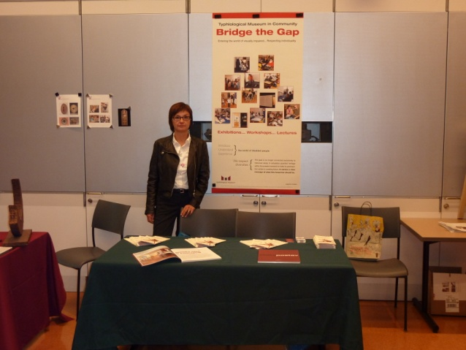
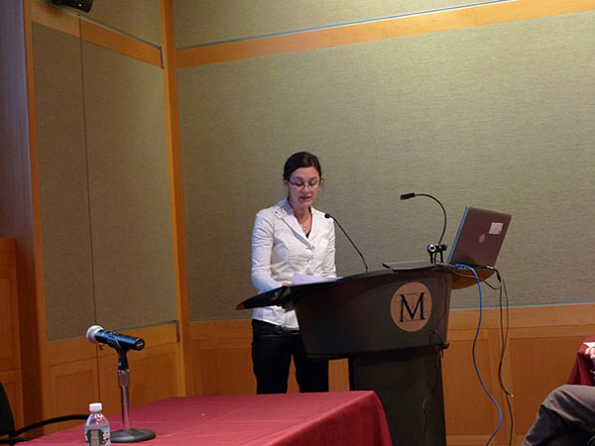
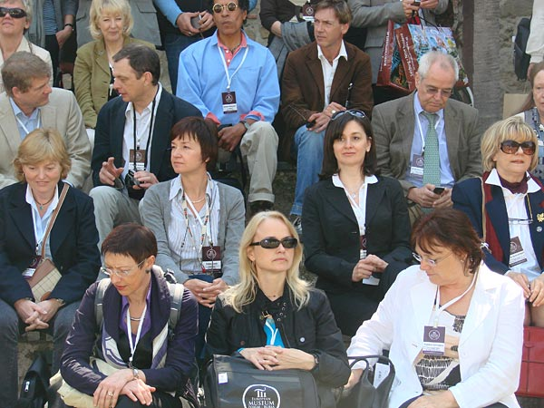
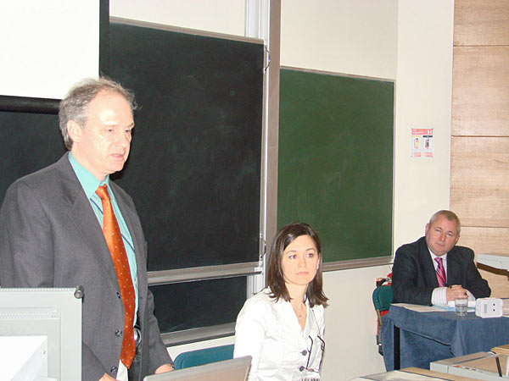
The Živa Award 2015, May, Saint Petersburg
Starting anew - 2008 →
Promoting the museum in Europe and more
Notes:
After the opening of the new permanent exhibition, we promoted it at home, in Croatia, in the region and throughout Europe:
Ireland (Museum and visually impaired – the place of adaptation, education and sensibilization, Living in a Changing Europe, ICEVI 7th European Conference, Dublin, 2009)
England (Access to museums and galleries for people who are blind and partially sighted, London, 2009.; Museums Association Conference, Liverpool, 2013)
Finland (European Museum of the Year Award, Tampere, 2010)
Turkey (European Museum of the Year Award, Bursa, 2009)
Italy (Museo tatile Anteros, Istituto Francesco Cavazza, Bologna; Museo Tatille Statale Omero, Ancona, 2006)
France (Musée du quai Branly, Paris; Cité des Sciences et de l'Industrie Direction te Musée des Beaux Arts, Arrass, 2008)
Austria (Art for all, Bundesblindenerziehunginstitut, Vienna, 2006)
Germany (Art for all, Universitätsmuseum, Marburg, 2007)
Bulgaria (Equal Access to Development Education for All (EADEA), Sofia, 2013)
USA (Museum in Community – Bridge the Gap, Art Beyond Sight, Multimodal Approaches to Learning, New York; Perkins School for the Blind, Boston, 2009)
China (Pride and Prejudice, 22. General Conference & 25th General Assembly of the International Council of Museum, Shanghai, 2010)

Slide 8
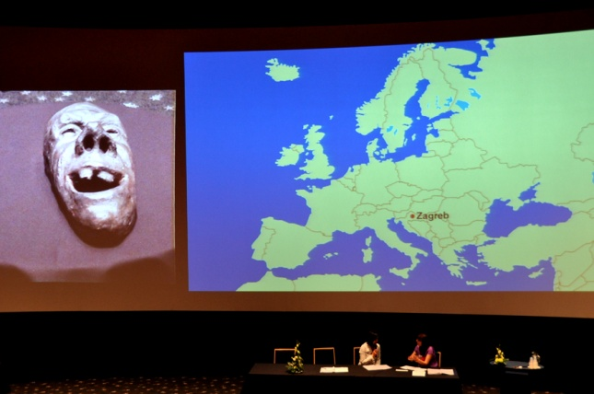
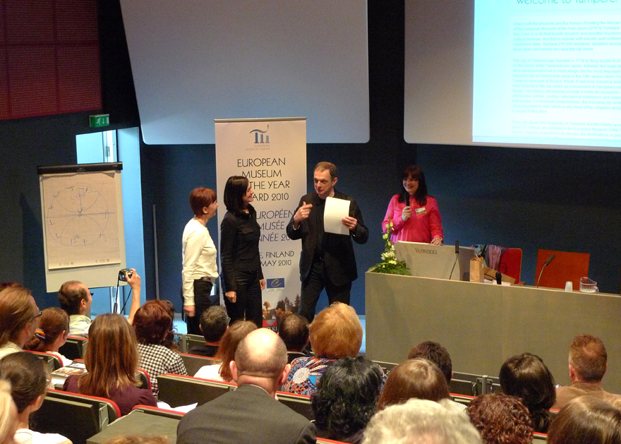
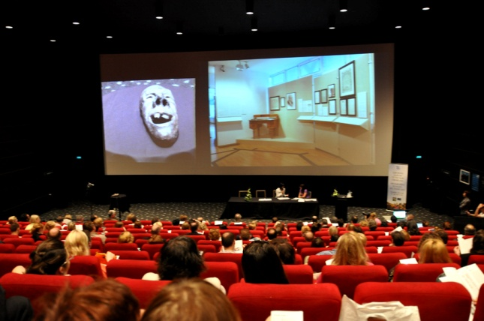
The Živa Award 2015, May, Saint Petersburg
Starting anew - 2008 →
2010 – EMYA nomination (the 3rd best museum presentation)
Notes:
We were nominated for 2010 EMYA (European Museum of the year Award) in Tampere, Finland. In addition, our presentation was recognized by conference participants - museum professionals as one of the top three.

Slide 9
The Živa Award 2015, May, Saint Petersburg
Starting anew - 2008 →
Expanded activities – actual social issues
Elderly persons
Violence, crime
Alcohol, drugs, PTSD
Sexual orientation, gender equality
Minorities, etc.
Notes:
After 2008, we expanded our activities to actual social issues, including elderly people, violence, crime, alcohol, drugs, PTSD, sexual orientation, gender equality, minorities, etc.

Slide 10

The Živa Award 2015, May, Saint Petersburg
Why us?
Notes:
What makes the Typhlological Museum of Zagreb a worthy candidate for the Živa Award?
Initially a no-name, the Typhlological Museum has become a respectable museum in the region recognized by the European museum community over the past few years.

Slide 11
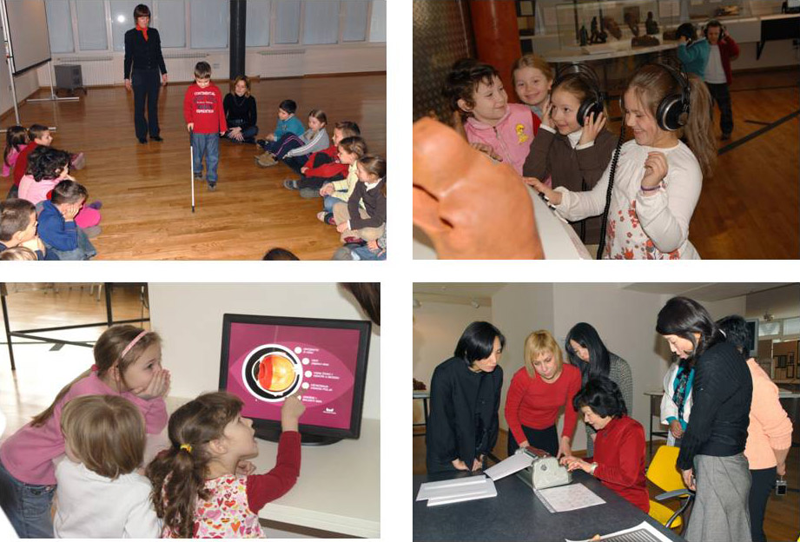
The Živa Award 2015, May, Saint Petersburg
Because ... of the future
Notes:
Because... of the future We have an excellent feedback from our visitors; we have the quality recognized in public.

Slide 12
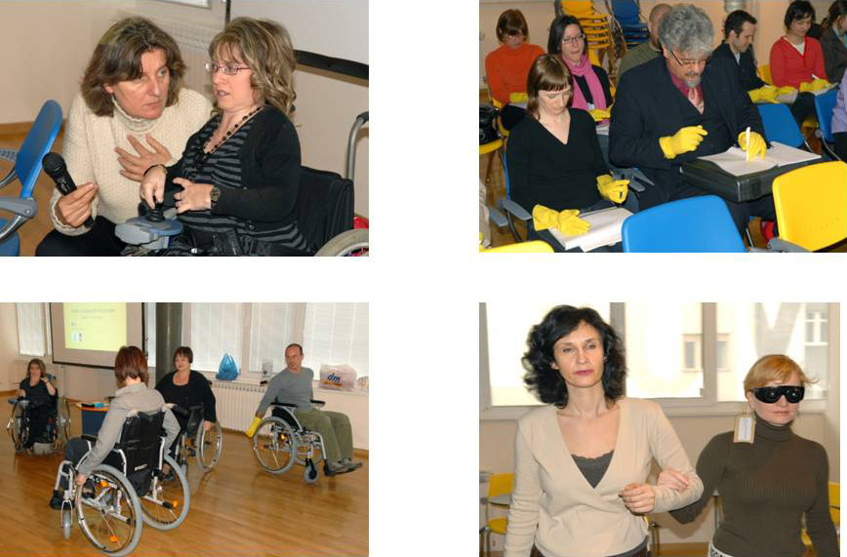
The Živa Award 2015, May, Saint Petersburg
Because ... we care
Notes:
Because... we care Our interactive exhibitions with many workshops for orientation and mobility, writing in Braille, problems with fine motor skills, using the wheelchair etc.

Slide 13
The Živa Award 2015, May, Saint Petersburg
Because ... we are unique
The only state museum in the world dealing with persons with disabilities
Semi-open museum collections storage
Highly professional staff: Experts - special educators
Notes:
Because... we are unigue We are the only state museum dealing with the problems of persons with disabilities. We have a semi-open storage, meaning we allow small group visits, and highly professional staff – our curators are special educators and each of them is a disability specialist in a particular field (blindness, deafness, physical disability, intellectual disability...).

Slide 14
The Živa Award 2015, May, Saint Petersburg
Because ... we are specific
The point of reference for the disability issues for heritage institutions
Adaptation
Modern interactive permanent exhibition
We are engaged in two scientific fields: museology and educational rehabilitation
Notes:
Because... we are specific Our museum is the point of reference for disability problems for heritage institutions in Croatia. The whole exhibition area has been adapted to persons with disabilities. We have a modern and interactive permanent exhibition. It is engaged in two scientific fields: museology and educational rehabilitation.

Slide 15
The Živa Award 2015, May, Saint Petersburg
Because ... of our awareness
The place where the possibility of the dialogue between social community and persons with disabilities is offered
We introduce and inform “healthy people“ about those who are not
Notes:
Because... of our awareness The Museum is the place offering the opportunity for dialogue between social communities and persons with disabilities. We introduce and inform “healthy“ people about those who are not.

Slide 16
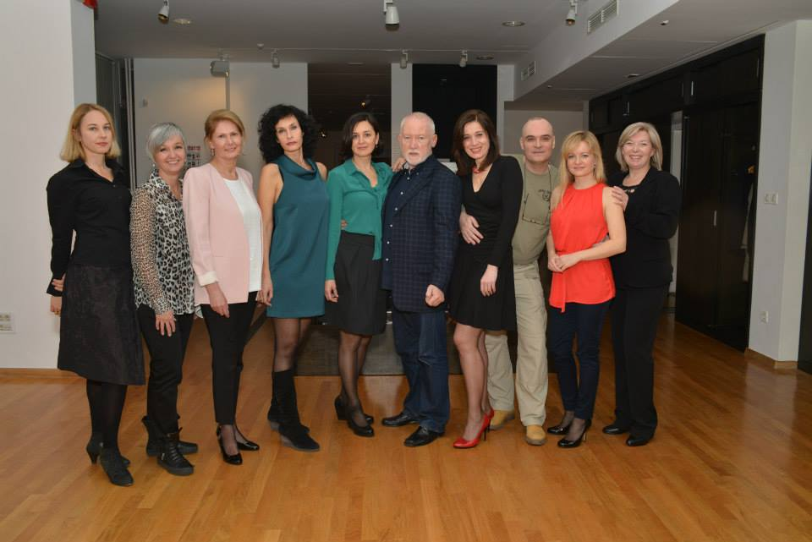
The Živa Award 2015, May, Saint Petersburg
Because ... of our strenghts
Teamwork and good human relations
Notes:
Because ... of our strengths Our strongest points are good human relations and teamwork.

Slide 17
The Živa Award 2015, May, Saint Petersburg
Because of our spirit ...
Notes:
Because of our spirit ...
♫ Always look on the bright side of life ... ♫

Slide 18
The Živa Award 2015, May, Saint Petersburg
Because we are ...
Museum for all
... with intention to encourage individuals to act and show the public that they are equally worthy and important
Notes:
We are a Museum for all … with intention to encourage individuals to act and show the public they are equally worthy and important.

